Slide 1
Traffic Control System
Traffic control system is used to improve the flow of vehicle traffic and improve safety. Real-time traffic data flows into a transportation management center where it is integrated and processed for incident detection and may result in actions taken such as traffic routing.
- System keeps track of drivers’ information such as driver license number, person name, birthdate and list of owned cars. Driver can own a maximum of 3 cars.
- For each registered car, the system stores the car plate number, model, list of recorded fines and production year.
- For each fine, system stores its value, street name, date and status (paid/not).
- Traffic man detects the plate number and measures the speed of the passing car. If the car speed exceeds the road maximum speed, a violation is recorded with a specific fine. The fine equals double the difference between the car speed and the road maximum speed.
- System can show the total amount of unpaid fines for a specific driver.
- User can pay the fine for one of his cars and his record is updated accordingly.
- Search is available for a specific car via its plate number or the owner name.

Slide 2
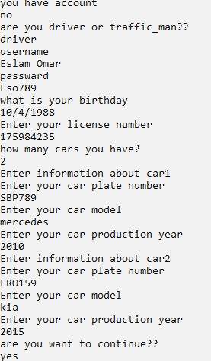
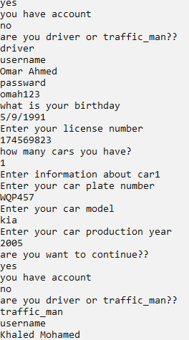
Traffic Control System

Slide 3
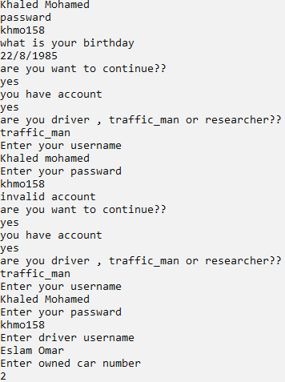
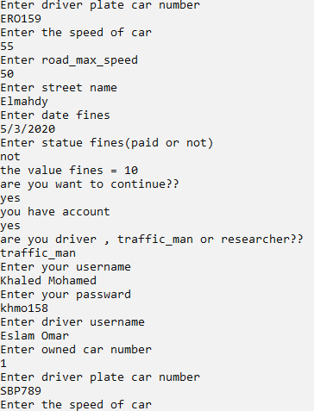
Traffic Control System

Slide 4
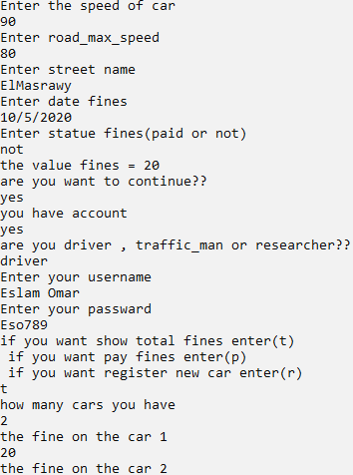
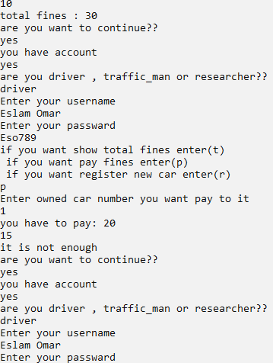
Traffic Control System

Slide 5
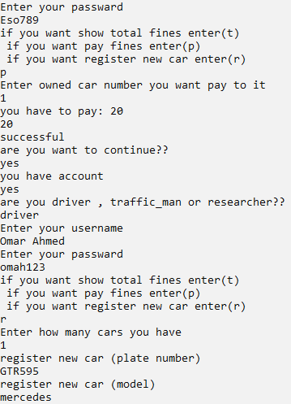
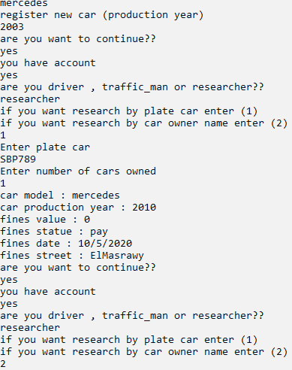
Traffic Control System

Slide 6
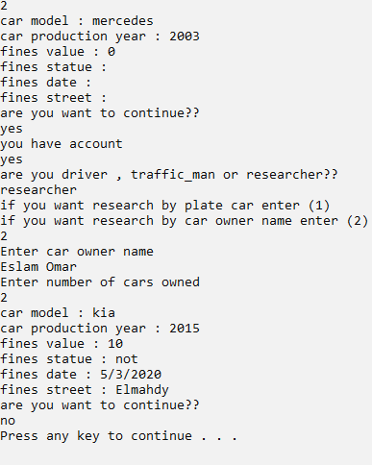
Traffic Control System

Slide 7
GitHub

